Slide 1

AMS
Annual General Meeting
22 November 2024

Slide 2

Agenda
Item | Description | Responsible
1 | Who is AMS? | John Craig
2 | AMS Achievements April 23 – March 24 | Mandy Martin
3 | Treasurer’s report / Financial statements & Annual Report | Ian Collins
4 | Election of Trustees - Proposals for Approval & Next Steps | Ian Collins
5 | Questions to Trustees | All

Slide 3

Who is AMS?
AMS is a charitable organisation
  We are Not for Profit
    All income is used to deliver the activities of AMS
    As a Charity, Gift Aid is extremely important
  The Objectives of AMS are to serve the Community and individuals by fostering & promoting educational, health, social & life skills
Aim is to use sport, exercise & leisure activities to achieve the objectives of:
  Advancement of Education & Advancement of Community Development
  Relief of those in need by reason on Age, Ill-health, Disability, Financial Hardship etc
  Advancement of Public Participation in Sport & Provision of Recreational Facilities
AMS has a Board of Trustees which assists with the Governance of the Charity
  Trustees are non-paid volunteers being:
  Austin MacPhee – Coach with Aston Villa FC since 2021, having held roles with Scotland, Northern Ireland & Hearts. Locally his coaching career started successfully with Cupar Hearts, before moving to Cowdenbeath & then onto St Mirren. Austin is 110% committed to AMS having started the organization in 2007.
  John Craig – Owner of DC Consulting a Business Advisory firm in Dundee / Edinburgh. Having lived locally for 20 years, my son Nairn attended AMS from the age of 3 through to 16-year-old and having seen the positive environment that AMS provided, this was the catalyst for my involvement & I have held the Chair role with AMS since 2017.
  Ian Collins – Ian’s day job involves working in a bank leading its agricultural team across Scotland and the north of England. Ian’s eldest son Tom was a coach up until 2021 and his youngest son James played with the club from the age of around 8 and more recently has coached various age groups. Ian also volunteers locally as the Chair of Live Active Leisure in Perth and Kinross and is a director within the Hillcrest organisation in Dundee.
  Helen Honeyman – Helen’s day job is managing HR, communication & operations functions for a local Pension Fund. Her original interest in AMS was through her son, who played for AMS since age 7 & last year he was the captain of the 2007’s Cup & League winning team.

Slide 4
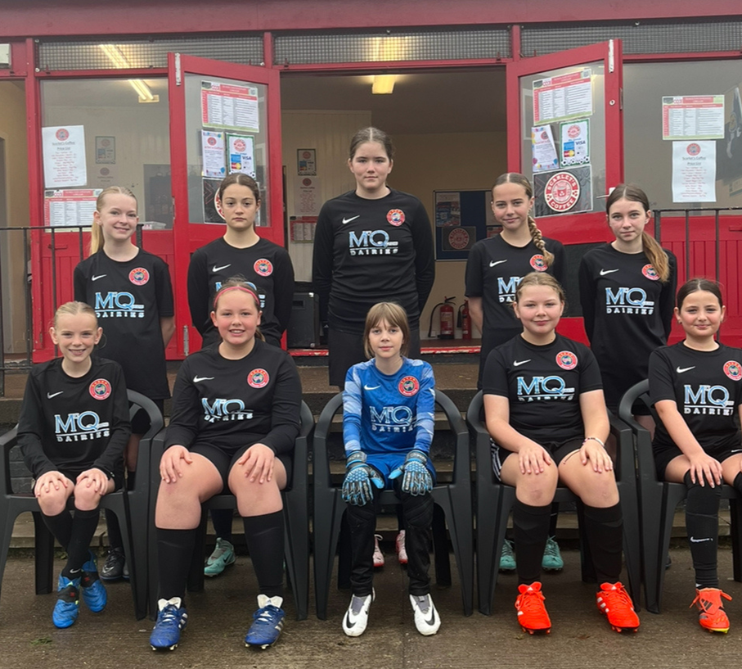
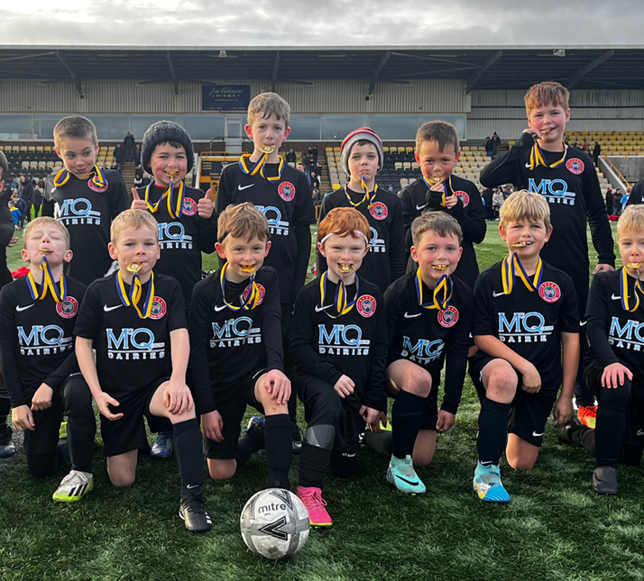
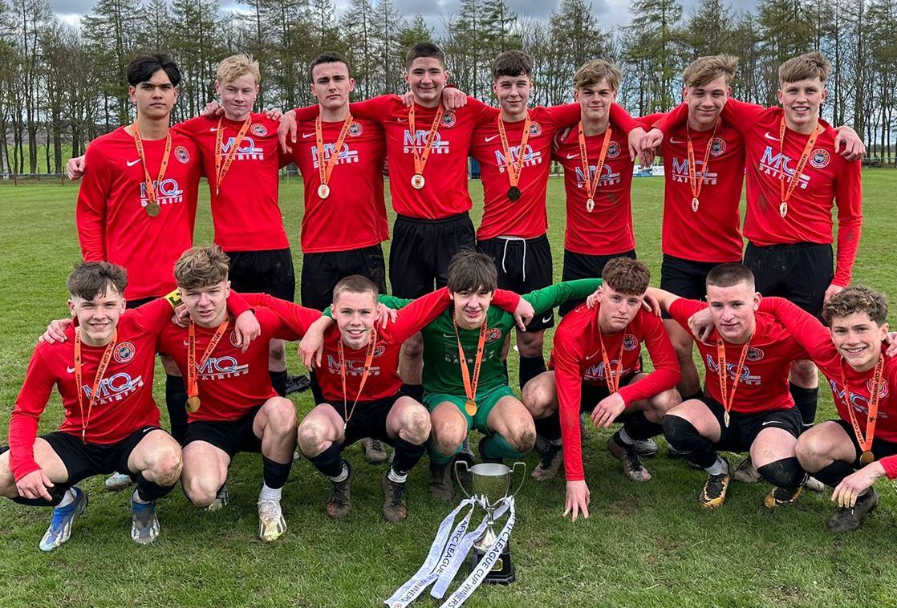
Headline Achievements 2024 - Teams
2007 age group collected a Cup and League Title.
2009 were beaten finalists in the Fife Cup.
2012 traveled to London for a Tour.
2014 and 2010 played in tournaments in Blackpool and Loughborough
U12 Girls competed in the Hibs tournament

Slide 5
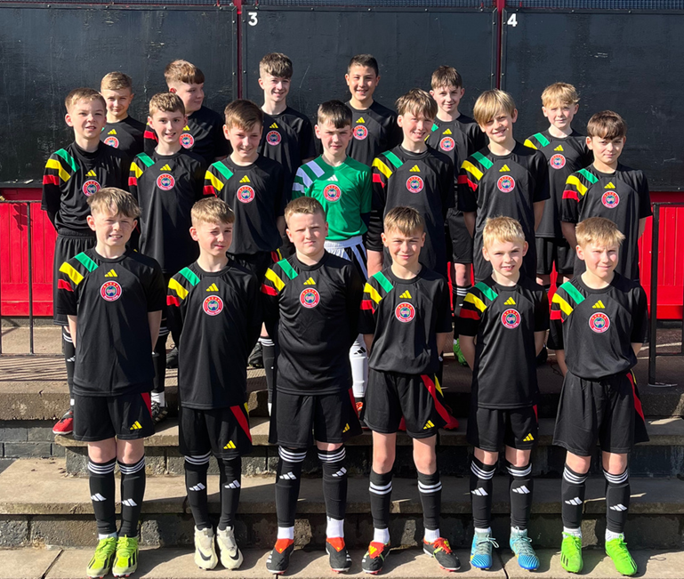
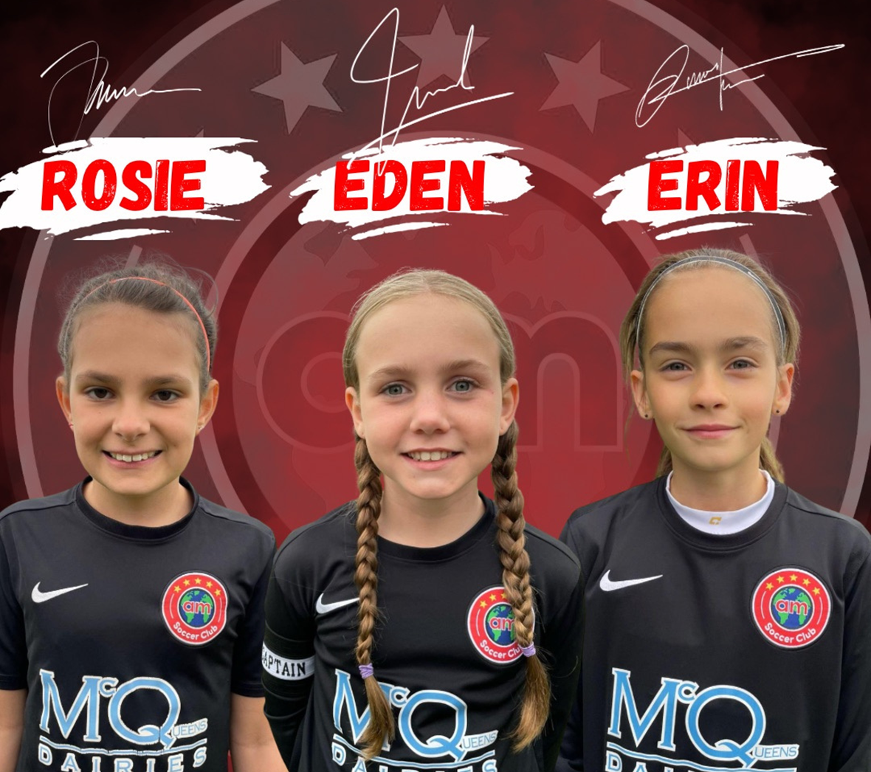
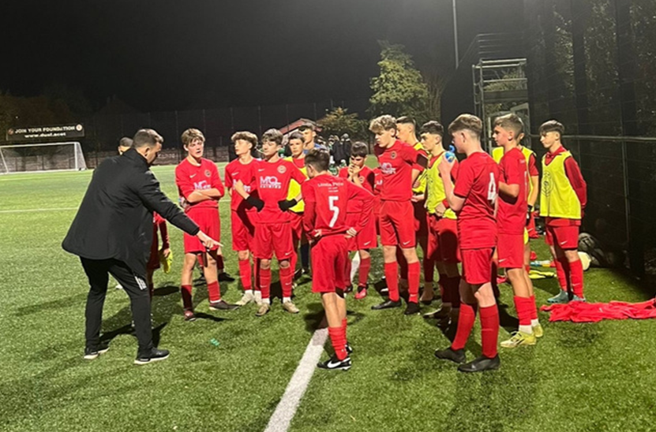
Headline Achievements 2024 - Players
  3 Girls selected for emerging Talent Centre
  2 Players into Academies
  Cross Age Group games against DUFC
  11 A-Side Specific Camps
  Games for Cupar Hearts

Slide 6

Other Achievements 2024
Over 300 players at AM Soccer Club from age 18 months to 83 years of age
Active Schools - term time delivery of football within NE Fife and the East Neuk primary schools
The pavilion has been upgraded through the sheer determination & commitment of the Fitchet family. The kitchen area has been improved & “Scarlet’s Coffee and Tuck shop” now operates from the pavilion. This generates additional funds which is being utilised for kit purchases etc.
The Club are continuing to seek a new main sponsor for 2025 after McQueens Dairies sponsorship deal came to an end in 2024.

Slide 7

Treasurer's Report

Slide 8
Treasurer’s Report – April 23 to March 24
Commentary
Income for the year to March 24 was £7k up on the prior year.
  The year to March 2025 is forecasting at circa £160k which is £20k lower which is due to lower sponsorship etc (circa £10k) and circa £10k less due to recharges with regard People Costs
Expenditure for year to March 24 was £181,000 which is £15k lower than the prior year which is positive
  Forecast expenditure to March 25 is circa £20k lower than March 24 which is partly due to people recharges (see above re income) other cost controls
Break-even for the year to March 2024 which is a positive turn-around from the prior year.

Slide 9
Committee Proposals for Approval

Slide 10
Re-Election of Trustees
Re-appointment of:
  John Craig
  Ian Collins
  Helen Honeyman
Re-confirmation of Austin MacPhee as Honorary Trustee
Change to the Constitution to reduce number of Committee Meetings from six to four p.a.

Slide 11
Proposals for Approval & Next Steps
Proposals for Approval
National Minimum Wage rose by 10% in April 2024 & will rise by a further circa 7% in April 2025, coupled with as increase to Employers NIC rates. As a consequence:
  We propose that the monthly costs will increase from 1 February 2025 as follows:
  General membership = £52.50 to £59.50
  AMS Girls & Soccer School = £44.50 to £50.50
  AM SoccerOne = £30 to £33.50
  AM SoccerTots = £25 to £28.50
  In line with the above increase, propose that the AMS membership for Gift Aid increase from £25 to £28.50
Next Steps
As already outlined, AMS is reliant on energetic & resourceful volunteers (NB Trustees are never paid) and therefore over the next 3 months we will be confirming areas which we need to augment via both Trustee or Volunteer roles & will therefore be asking for support from the wider membership in order to ensure the ongoing running of this key community asset.
Specific areas we will be looking at will include:
  Charity Governance
  Social Media & Marketing
  Sponsorship & Fundraising

Slide 12

Members’ Questions

